Slide 1

[Samsung PRISM] Mid Review Report
AI/ML: Age,Gender and emotion detection from speech
Team
College Professor(s):
1) Dr J Selvin Paul Peter, Associate Professor, Department of Computing Technologies, selvinpj@srmist.edu.in
2)Dr P Murali, Associate Professor, Department of Computing Technologies, muralip@srmist.edu.in
Students:
Rishabh Agrawal / ra7546@srmist
Raghav Khanna / ri9320@srmist.edu.in
Aaryaman bajaj / an1143@srmist.edu.in
Nilanjana Bhattacharya / nb2168@srmist.edu.in
Department: Cse Core (Computing Technologies)
Date: 20 Oct 2023

Slide 2
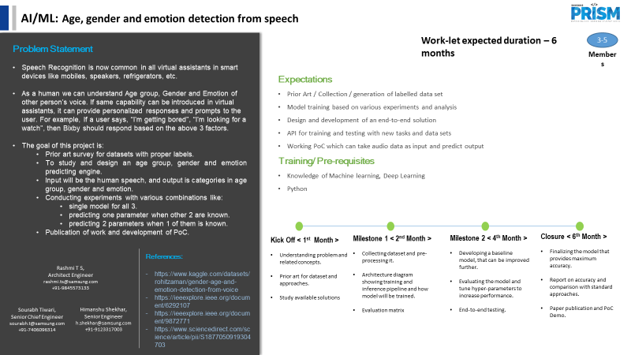

Information Retrieval | SQL to Lucene Query Parser
Notes:
-

Slide 3
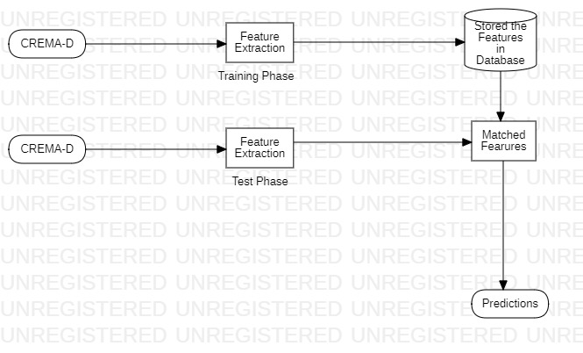
Proposed Approach / Solution
Concept Diagram :

Slide 4
Dataset(s) Analysis / Description
Dataset Capture/ Preparation/Generation
We are using the crema d dataset.
The pipeline takes an audio file as a input
it generates a csv file containing spectral contrast, spectral roll off, spectral contrast and mfcc features.
Dataset Understanding / Analysis :
The crema d dataset has 48 male and 43 female actors between the ages of 20 and 74.
it identifies 6 emotions : Anger, Disgust, Fear, Happy, Neutral, and Sad

Slide 5
Dataset(s) Analysis / Description
Dataset Pre-Processing
Initialization: The function begins by initializing a StandardScaler, which is a common tool for feature scaling in machine learning.
Feature Selection: It selects the features to be scaled by excluding the last column from the input data using data.iloc[:, 0:-1]. This assumes that the last column contains the labels and should not be scaled.
Scaling:The selected features are then scaled using the scaler.fit_transform method. Scaling is crucial for standardizing the data, ensuring that all features have a mean of 0 and a standard deviation of 1.
Returned Values: The function returns two values - the scaled data, which is the transformed feature matrix, and the scaler object.
Purpose: This function is commonly used in machine learning to preprocess data before training a model. Scaling features helps prevent some features from dominating the learning process due to differences in their scales, leading to more stable and accurate models.

Slide 6
Dataset(s) Analysis / Description
Dataset Pre-Processing / Related Challenges
Data Quality Variation: The CREMA-D dataset contains audio samples from various sources, which can lead to variations in audio quality, background noise, and recording conditionsFile
Format and Metadata: Inconsistent file formats or missing metadata in the dataset
Dimensionality Reduction: High-dimensional audio features like MFCCs may require dimensionality reduction techniques

Slide 7
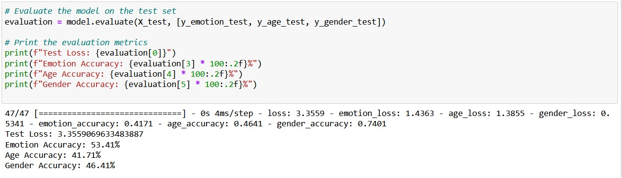
Experimental Results / Simulations / Observations
RESULTS

Slide 8
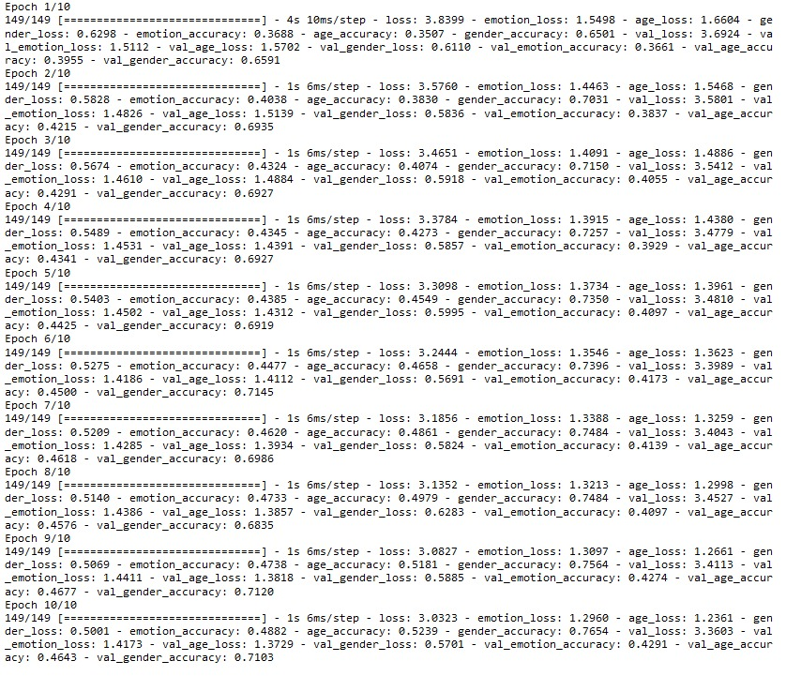
Experimental Results / Simulations / Observations
Major Observations / Conclusions & Challenges

Slide 9
Experimental Results / Simulations / Observations
Major Observations / Conclusions & Challenges
Extracted an end-to-end pipeline to extract relevant features from from any given voice sample data to feed into model.
Used CREMA-D and common Voice Dataset to create dataset with age,gender and emotion labeled.
CNN model trained to predict age, gender and emotion from voice extracted features.

Slide 10
Further Plan to Complete Project
Final Probable Deliverables
We have presently trained a single model for all three predictions.
We are trying to find the dependency of a particular feature on the other two.
We have currently made our pipeline to extract features from a pre-recorded wav file and then further evaluate it using model. We aim to be able to create a software to extract features from live voice samples, to help further integrate it into BIXBY or other voice assistant modules.

Slide 11
Further Plan to Complete Project
Completion Plan:
Week 1 to 2
Step 1 Address data quality issues and maintain metadata.
Step 2 Refine the feature extraction process and consider additional features if necessary.
Week 2 to 4
Step 1We will try to train multiple different deep learning models in order to find the best suitable predictions
Week 5 to 6
Step 1 design and develop user interfaces and user experience (UX) components.
Step 2 Gather feedback from users and stakeholders through surveys, interviews, and feedback forms.
Week 7 to 8
Step 1Analyze the feedback, prioritize improvements, and make necessary changes to enhance the project.
Step 2 work on optimizing our model for low-latency processing.
Step 2 Maintain an ongoing feedback loop, communicate improvements, and iterate to ensure the project continually meets user needs.
Git Upload details: Code done and ppt upload

Slide 12
Further Plan to Complete Project
Challenges Anticipated
Data Imbalance: Dealing with imbalanced datasets for age, gender, or emotion categories, which may lead to skewed model performance. Handling variations in recording quality and environmental noise in the data.
Data Quality and Diversity: Ensuring that the dataset is representative of diverse demographics in terms of age, gender, and emotional expressions can be a challenge
Bias and Fairness: Mitigating bias in the dataset and the model predictions is a crucial ethical concern. Models may perform differently for various demographic groups, which could lead to fairness issues.

Slide 13
Thank you

